Slide 1

Scope of Disclosure | OCUP team
Confidential period | Indefinite
Head of information owner section | Head of Training Division @TSIP
Handling restriction | “No Copying” , “No Printing” “No transferring”, “No re-disclosure” “No circulation” , “Do not duplicate”
Why We Model

Slide 2


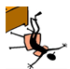
UML 2.5 discussions have been known to cause or induce sleep among participants.
Necessary precautions to prevent injuries due to participants falling off chairs ,resulting from UML-induced stupor is highly advised ☺
Please do not fall off the chair !

Slide 3

Let’s do UML !!

Slide 4

UML is only for Object Oriented guys !!
The customer does not need UML diagrams anyway –
Then why use it ? !!
As long as the product works, we do not need these diagrams !!
UML is only applicable if we have ample time !!
We would like to avoid long design documents which look like the Gita !!
We just need to rely on the genius in the team.
We can manage without UML, which is just for formatting !!
Sequence diagrams are all I need in UML !!
Time spent drawing these diagrams can be spent more beneficially in other activities !!
Resistance to Modeling

Slide 5
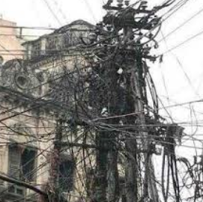
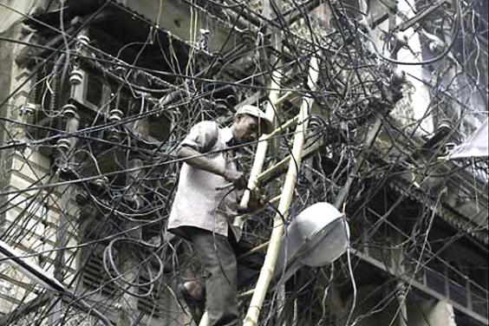
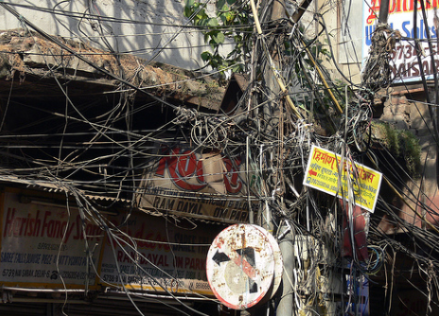
Crash & Burn !

Slide 6
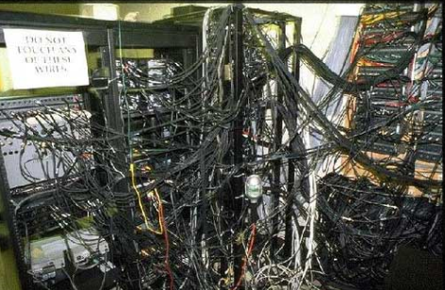
Crash & Burn !

Slide 7
To Model OR Not to Model ?

Slide 8
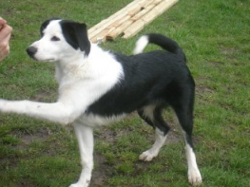
Annoying neighbour’s dog

Slide 9
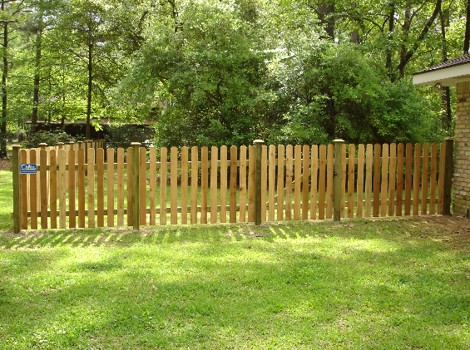

Slide 10
Specification : Picket Fence
Purpose : Deter the neighbour’s dog from wandering into the house
Length: 40 feet
Construction Period: 2 days
Features : 4 feet high wall + 3 inches spacing

Slide 11
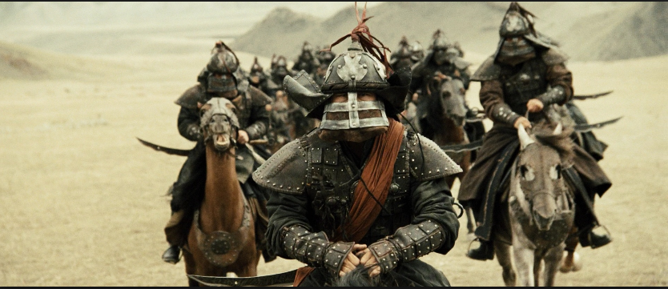
Invading Mongol warriors

Slide 12


Slide 13
Specification : The Great Wall of China
Purpose : Deter invading Mongol warriors.
Length: 13,170 miles
Construction Period: About 2,000 years (476 BC to 1644 AD )
Features : Watch towers, troop barracks, garrison stations along the wall

Slide 14
Model Value Analysis
Do you really need to Model here?
Most certainly, we need to Model here !

Slide 15
Model Value Analysis
Perform model value analysis to decide if a formal analysis or modelling is required or not*
Using a summary of the expected costs and the expected benefits, and a comparison of the two
Generally around 1% of actual modelling time
* Some systems which are very small with very low risks may not be required to be modeled.

Slide 16
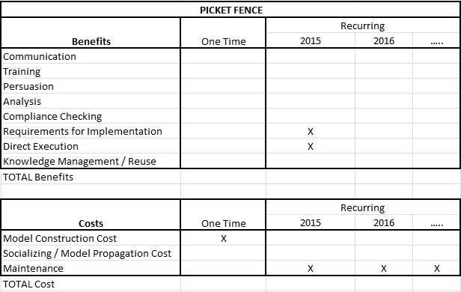
Model Value Analysis
[Picket Fence]

Slide 17
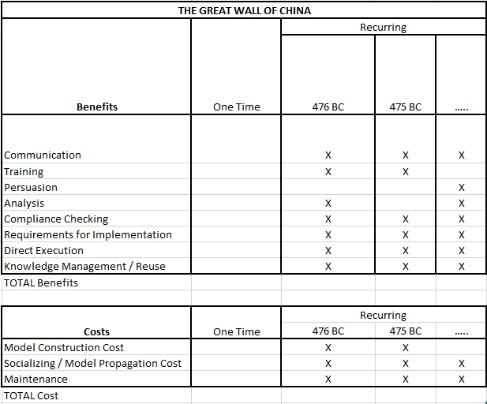
Model Value Analysis
[Great Wall of China]

Slide 18
When NOT to Model
The problem domain is well known.
The solution is relatively easy to construct.
Very few people need to collaborate to build or use the solution (often only one).
The solution requires minimal ongoing maintenance.
The scope of future needs is unlikely to grow substantially.

Slide 19
Model Value Destruction
Modeling Time = Time for creating a model
+
Time for using the model
Costs of creating and using a model are greater than the benefits that are gained from its use
Not every model should be built
Value destruction : An action (of creating/using the model) provides a smaller economic benefit than the cost of the action. Hence the value of some models begins to erode over time.

Slide 20
Scope Failures
Spending too much time building and refining a model, more time than the value that can be delivered from the model you are building
=> results in Model Value Destruction
Need to manage scope of the model
Manage Breadth of the Model = Items included in Model
Manage Depth of the Model = Amount of Detail

Slide 21
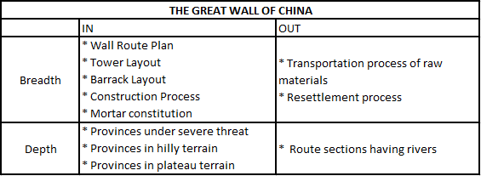
Scope Table

Slide 22
Models
Semantically closed abstraction of the system.
Is a ‘projection’ of the system
Models may encompass detailed plans, as well as more general plans that give a 30,000-foot view of the system under consideration.
Good Model : A good model includes those elements that have broad effect and omits those minor elements that are not relevant to the given level of abstraction.

Slide 23
Models help….
BluePrint : serves as a template that guides us in constructing a system
Manage : Risk & Complexity
Visualize : the entire system
Assess : the different options available
Communicate : the designs to all stakeholders
Specify : the structure or behavior of a system
Documents : the decisions made
Simplification : of existing mechanism become possible
Reuse : of existing systems become possible

Slide 24
Models help….
Assumptions are explicit
Internal consistency is ensured
Alterations: Logical consequences of altering model is known
Relation to data is known
calibration to historical data possible
can test model against existing data
Collaboration : Focal point of collaboration between multiple contributors
Sensitivity Analysis
Apply huge range of parameters over a vast range of possible scenarios to identify most salient uncertainties, regions of robustness, and important thresholds
Prediction is possible with models (e.g. statistical prediction)

Slide 25
Models help….
Explain (very distinct from predict) – e.g. earthquakes
Guide data collection using theory
– e.g. electromagnetic theory / theory of relativity
Illuminate core dynamics
– models are only abstractions, which depict ideal situations
- models can be inaccurate (only approximations)
Suggest dynamical analogies
– e.g. electrostatic & gravitational attraction
Discover new questions
Illuminate core uncertainties
Offer crisis options in near-real time
Demonstrate tradeoffs / suggest efficiencies
Challenge the robustness of prevailing theory
Train practitioners

Slide 26
Models of Complex Systems
Although modeling is not just for big systems, we build models of complex systems because we cannot comprehend such a large system in its entirety.
Through modeling, we narrow the problem we are studying by focusing on only one aspect at a time.
Divide & Conquer : Attack a hard problem by dividing it into a series of smaller problems that you can solve.
A model properly chosen can enable the modeler to work at higher levels of abstraction.

Slide 27
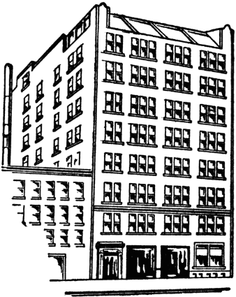
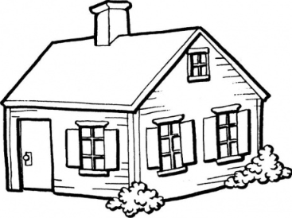
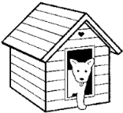
Models

Slide 28
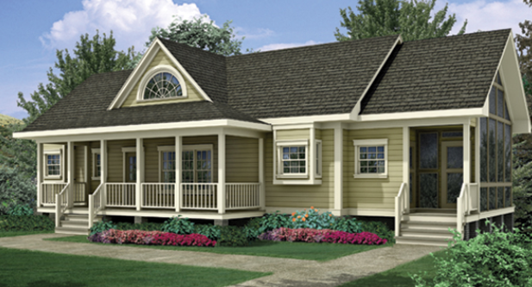
Model – Is an Abstraction
(simplification of reality)

Slide 29
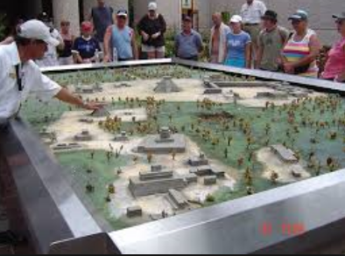
Model : Scale may be altered

Slide 30
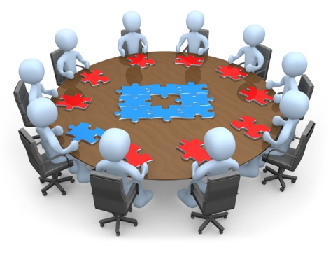
Model – A specific ViewPoint of the System
Every system may be described from different points of view using different models
Every nontrivial system is best approached through a small set of nearly independent models (No single model is sufficient)
Every model may be expressed at different levels of precision

Slide 31
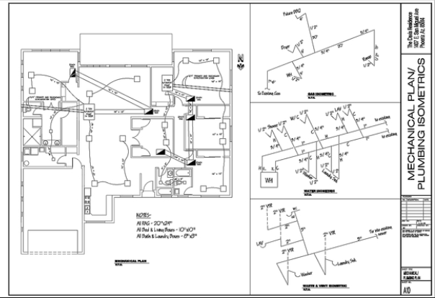
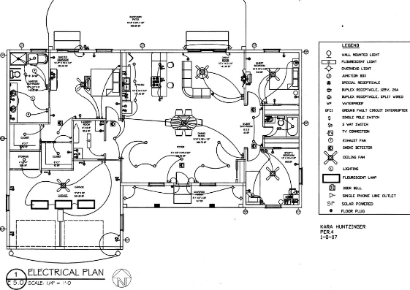
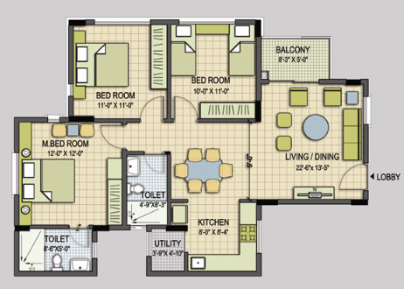
Ex : Different Models (ViewPoints) of Same System (House)
Electrical Plan
Plumbing Plan
Floor Plan

Slide 32
Models – Structural / Dynamic
A model may be structural
emphasizing the organization of the system
OR a model may be behavioral
emphasizing the dynamics of the system

Slide 33
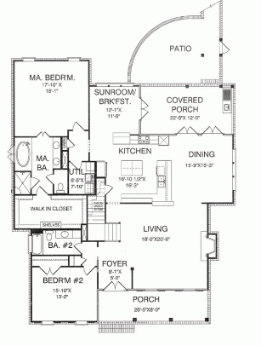
Structural Model

Slide 34
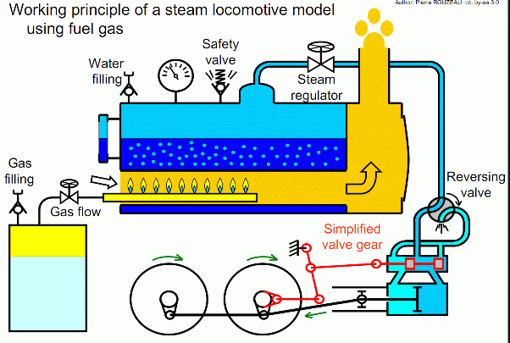
Dynamic Model

Slide 35
Domain Modeling
Way to describe and model real-world entities and the relationships between them, which collectively describe the problem space.
Very high system design which focusses on the problem (core domain) and models the solution using real-life entities.
In the Unified Modeling Language (UML), a class diagram is used to represent the domain model. Typically a set of domain objects which collaborate to fulfil system level goals.
Foundation for use case/workflow modelling

Slide 36
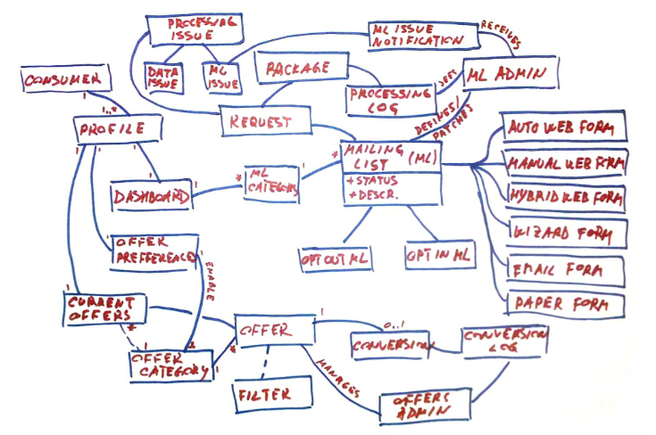

Slide 37

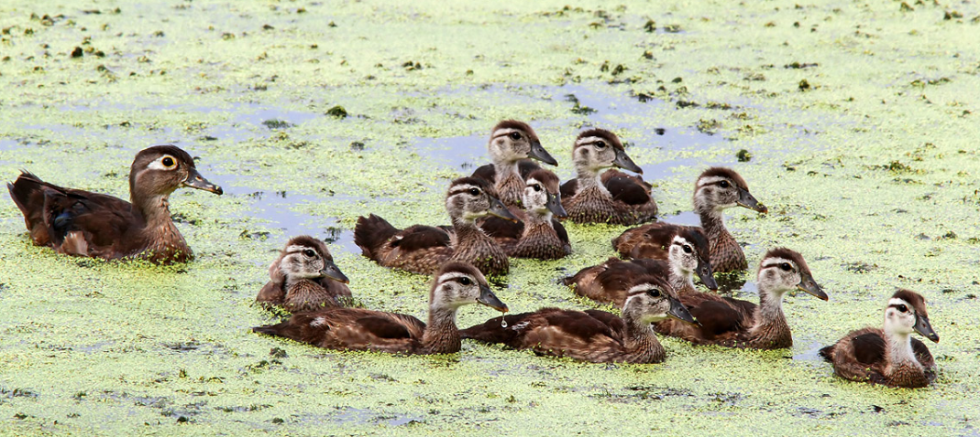

Domain : Hunting

Slide 38
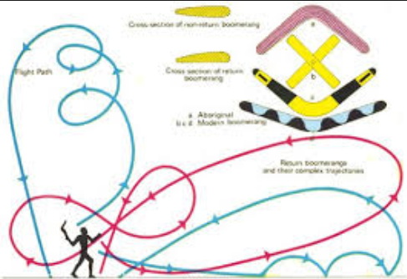
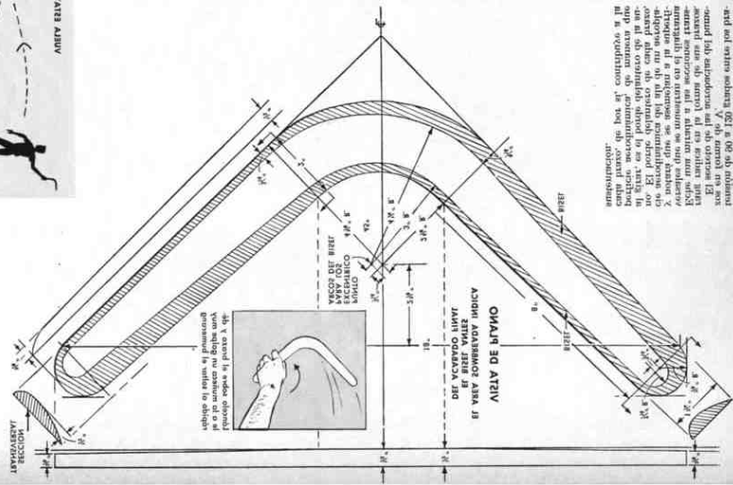
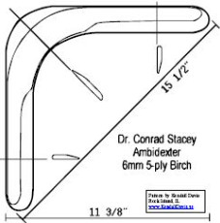
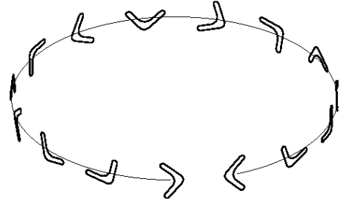
Boomerang Design :
[NOT domain modeling]

Slide 39
Why Model Software
Create and communicate software designs before committing additional resources
Trace the design back to the requirements, helping to ensure that they are building the right system
Practice iterative development, in which models and other higher levels of abstraction facilitate quick and frequent changes

Slide 40
Formal Software Modeling
Informal models are often ad hoc and do not provide a common language that can easily be shared with others.
Just as there exists a common language of blueprints for the construction industry, a common language for electrical engineering, and a common language for mathematical modeling, so too can a development organization benefit by using a common language for software modeling.

Slide 41
Object Oriented Modelling
Essence:
View main building block of all software systems as an object or class
Objects/Classes can be from solution space or problem space
Each object has identity, state and behavior
Large collection of collaborating objects

Slide 42
Object Oriented Modelling
Does NOT :
View system from algorithmic perspective
Treat procedures or functions to be main building blocks of a system
Focus on flow of control
Use functional decomposition of larger algorithms into smaller ones

Slide 43
Object Oriented Modelling
Uses several complementary and interlocking views
Use case view – for requirement modeling
Design view – for problem and solution space modeling
Process view – for modeling processes & threads
Implementation view – for physical realization
Deployment view – for system engineering issues

Slide 44
How do I model software ?
Software industry has accepted UML for modeling software
UML is a modeling language
UML defines syntax (graphical & textual) and semantics (underlying meaning of the symbols and text)
UML uses meta-modeling or ‘models of models’

Slide 45
UML
Modeling
Unified Language
^

Slide 46
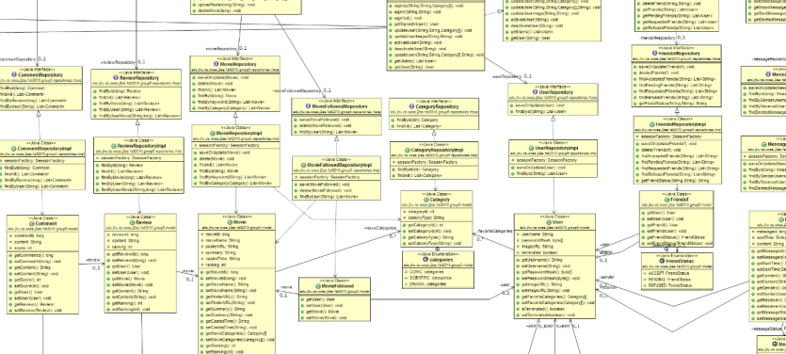
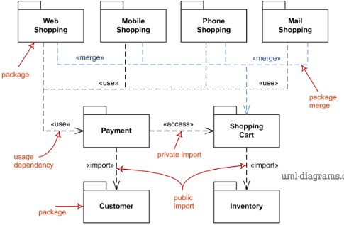
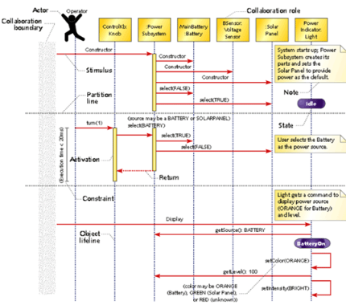
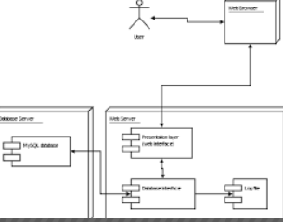
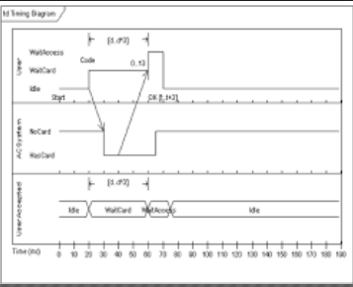
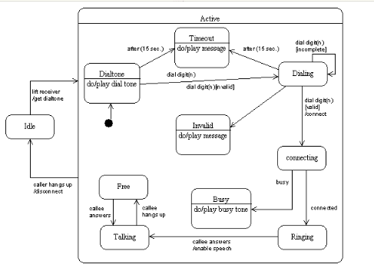
UML

Slide 47
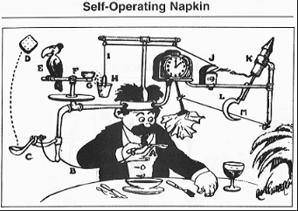
NO to Extreme Modeling

